Slide 1
Welcome to Election Workers’ Training Mifi and Poll Pad

Slide 2
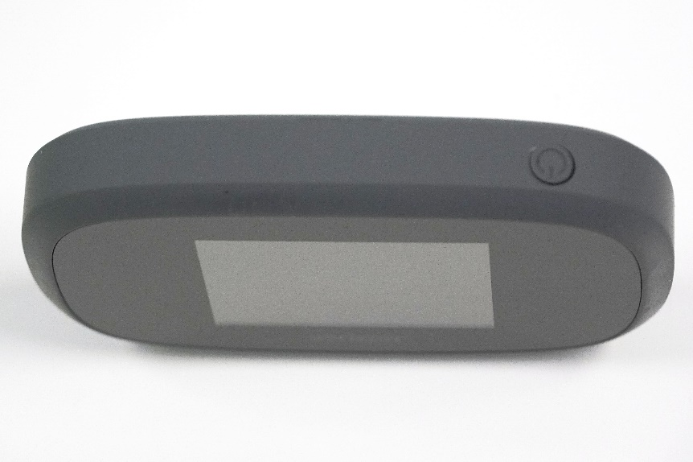
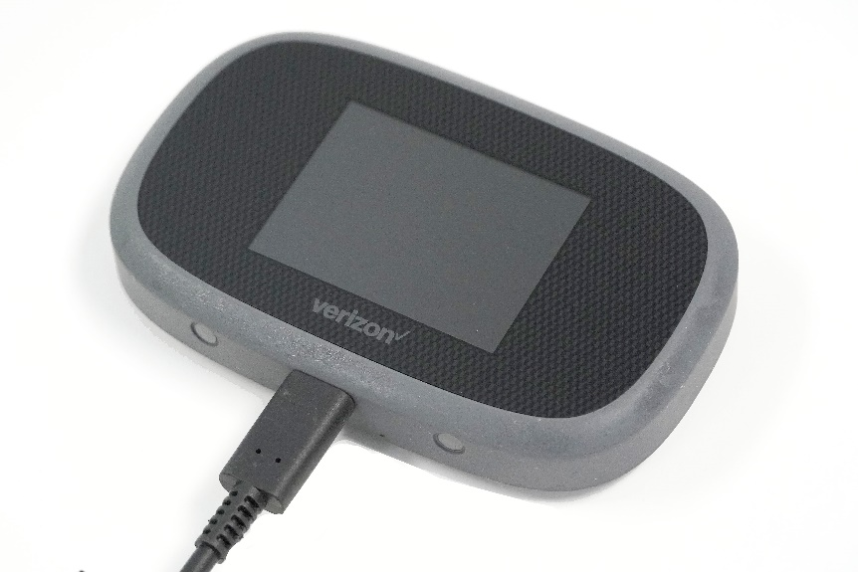
Equipment Set Up - Mifi
Power On Mifi
Connect power cable
Locate best wifi signal in room and plug into nearest outlet
Important! Mifi must be on before Poll Pad!

Slide 3
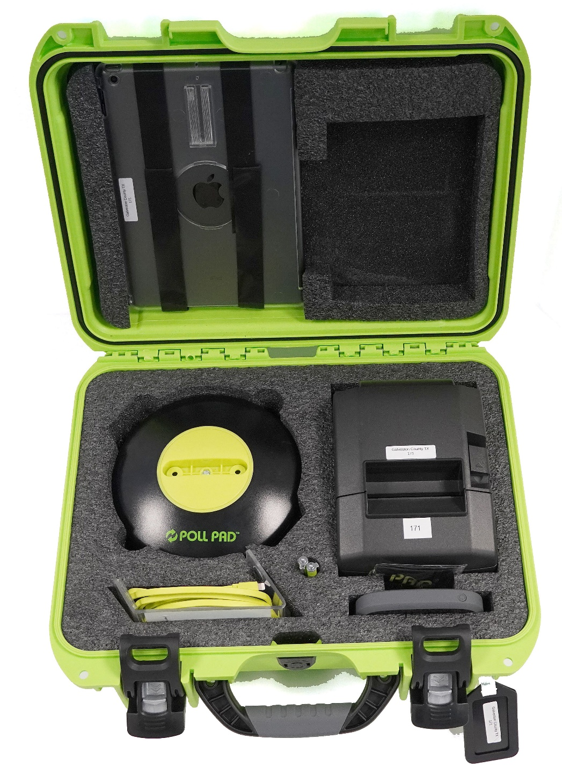
Equipment Set Up – Poll Pad
The case

Slide 4
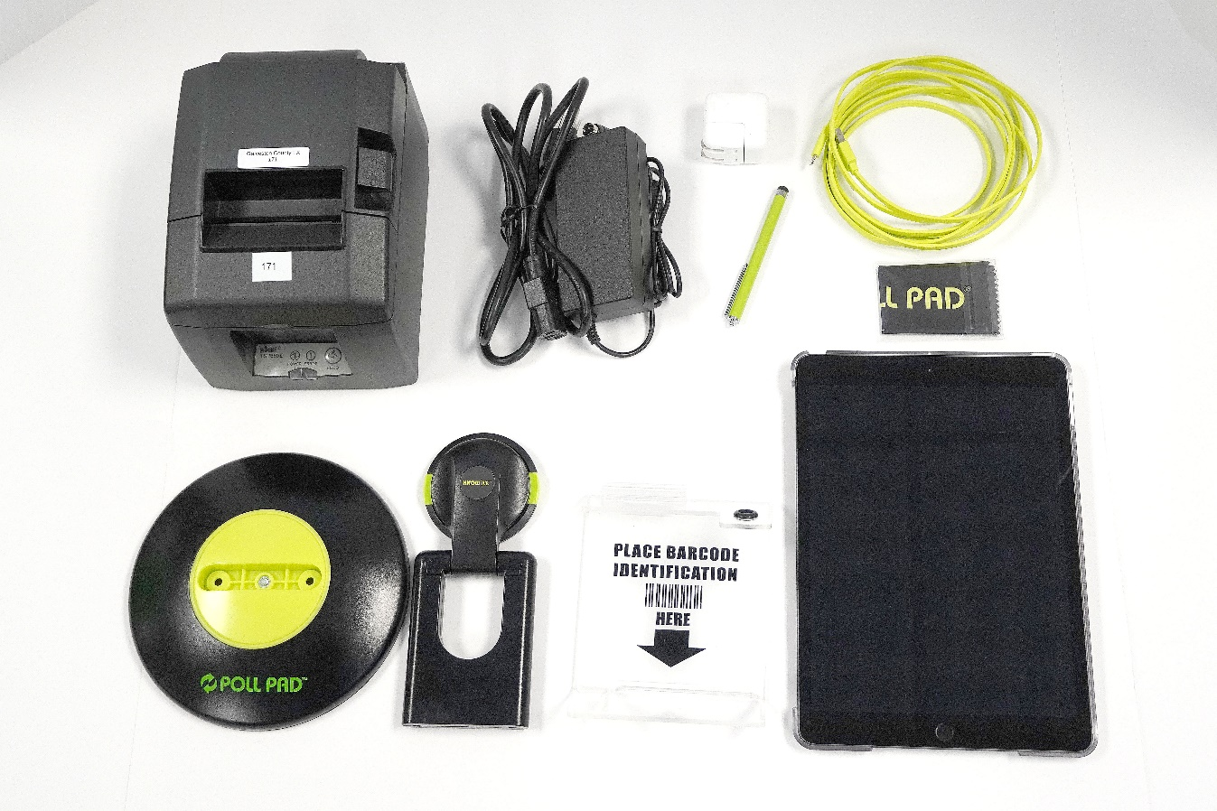
Equipment Set Up – Poll Pad
What’s inside?
Printer AC Power
Usb/AC Adapter
Stylus
Printer
USB Cable
Screen Cloth
Poll Pad
Base
Stand
ID Tray

Slide 5
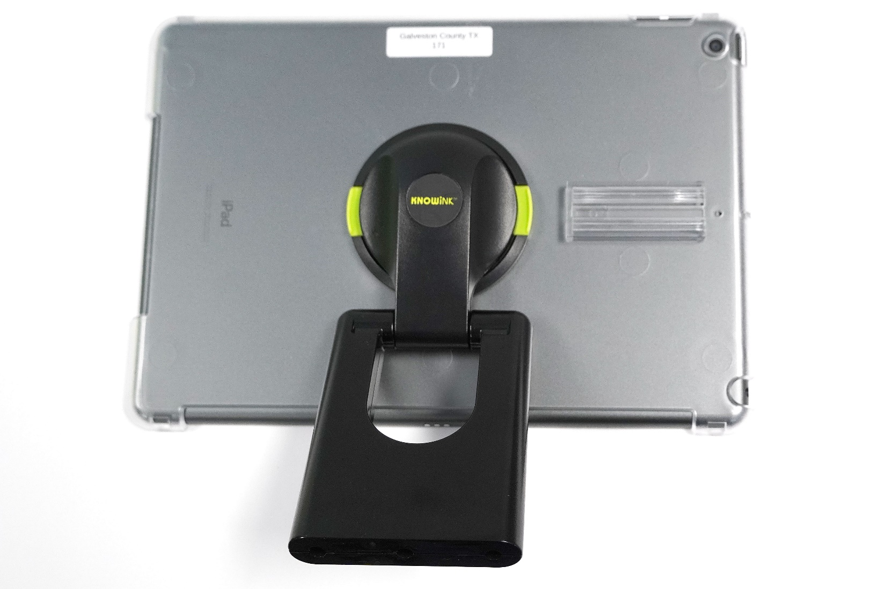
Equipment Set Up – Poll Pad
Connect the Stand to the Poll Pad by squeezing green tabs.

Slide 6
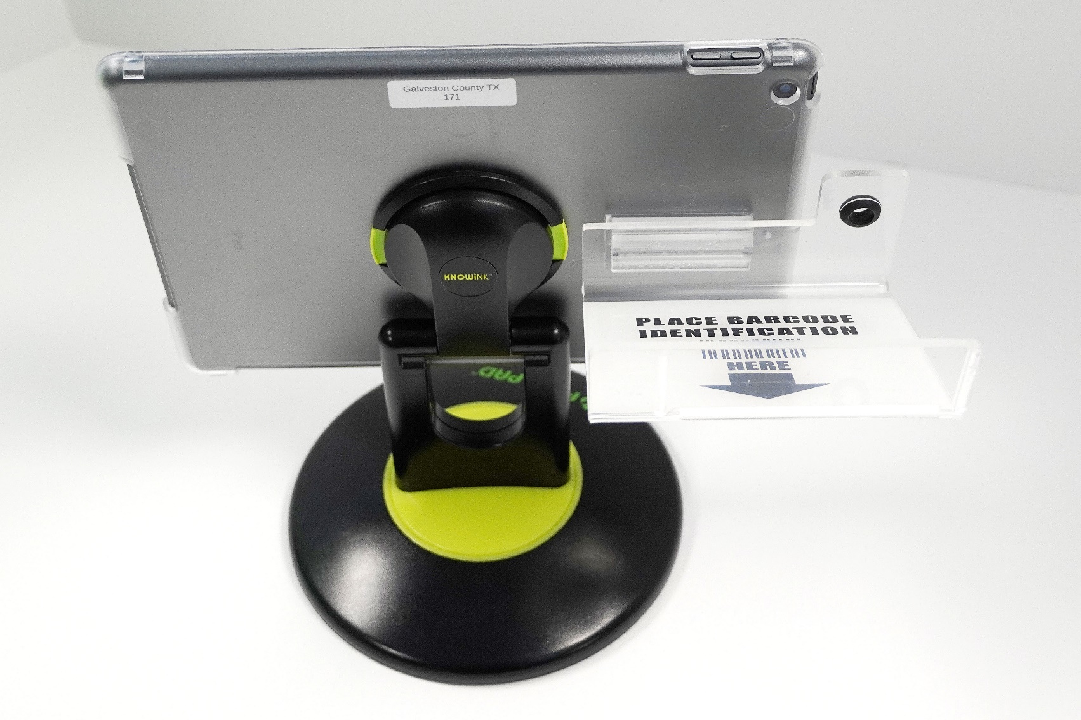
Equipment Set Up – Poll Pad
Connect the ID Tray to the Poll Pad.
Slide here

Slide 7
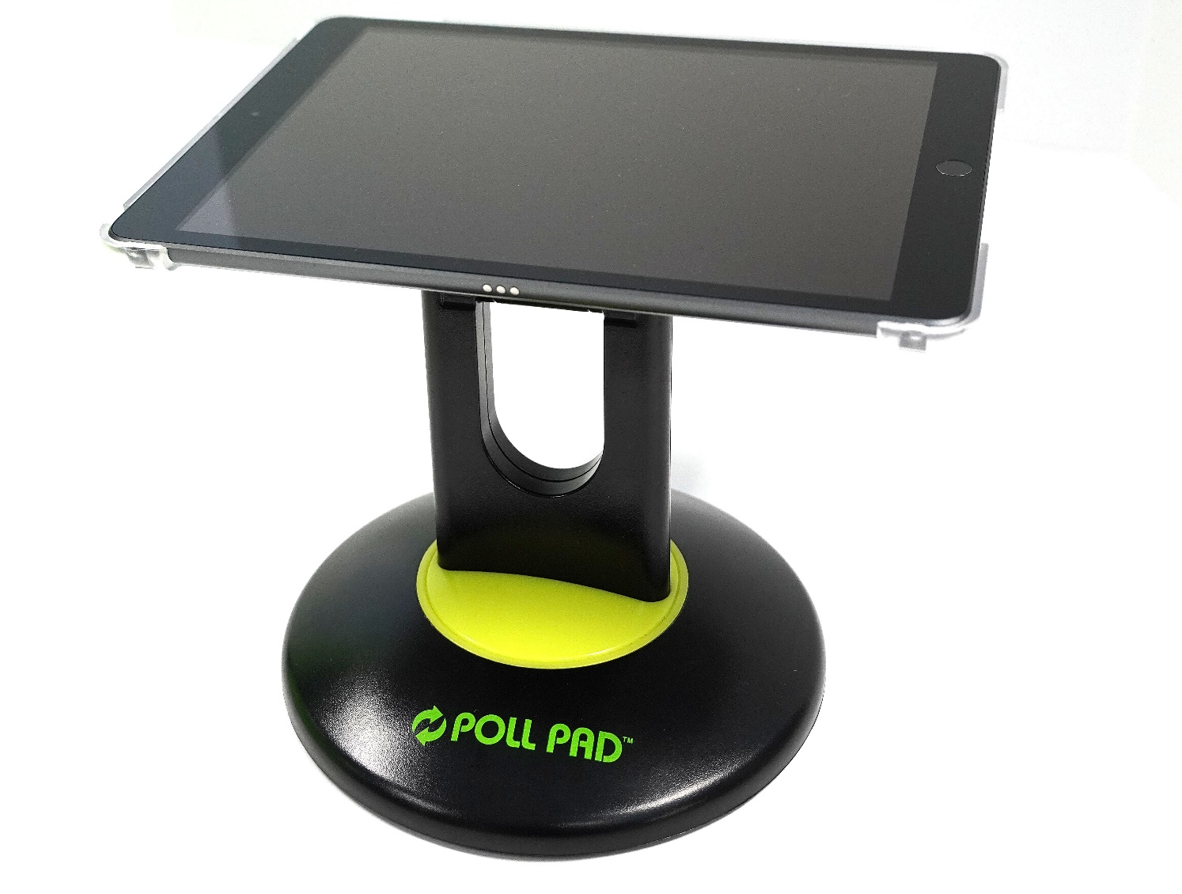
Equipment Set Up – Poll Pad
Connect the stand to the base.

Slide 8
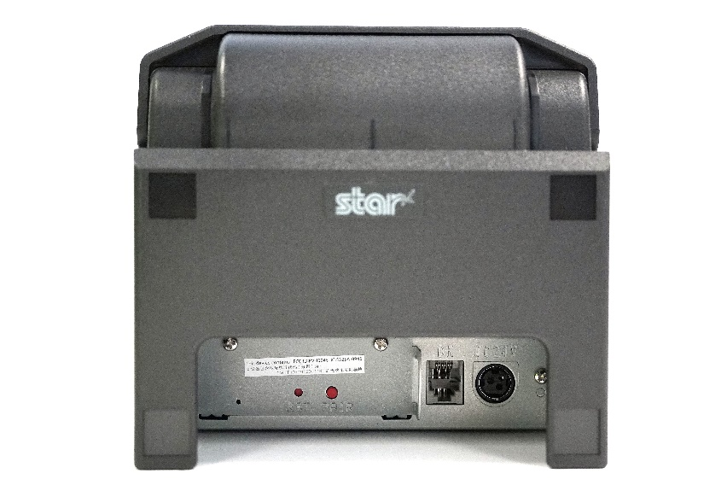
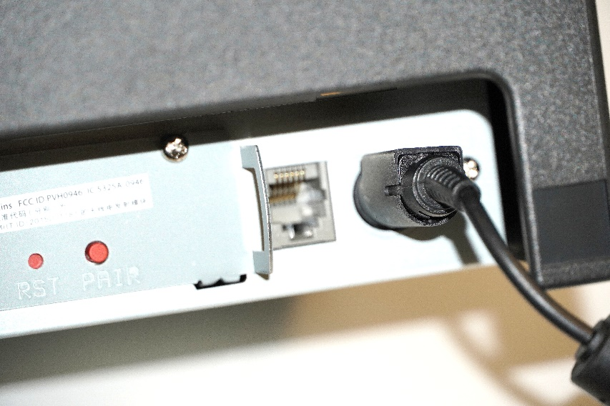
Equipment Set Up – Poll Pad
Connect the printer to AC power.
Plug goes here
Flat side up

Slide 9
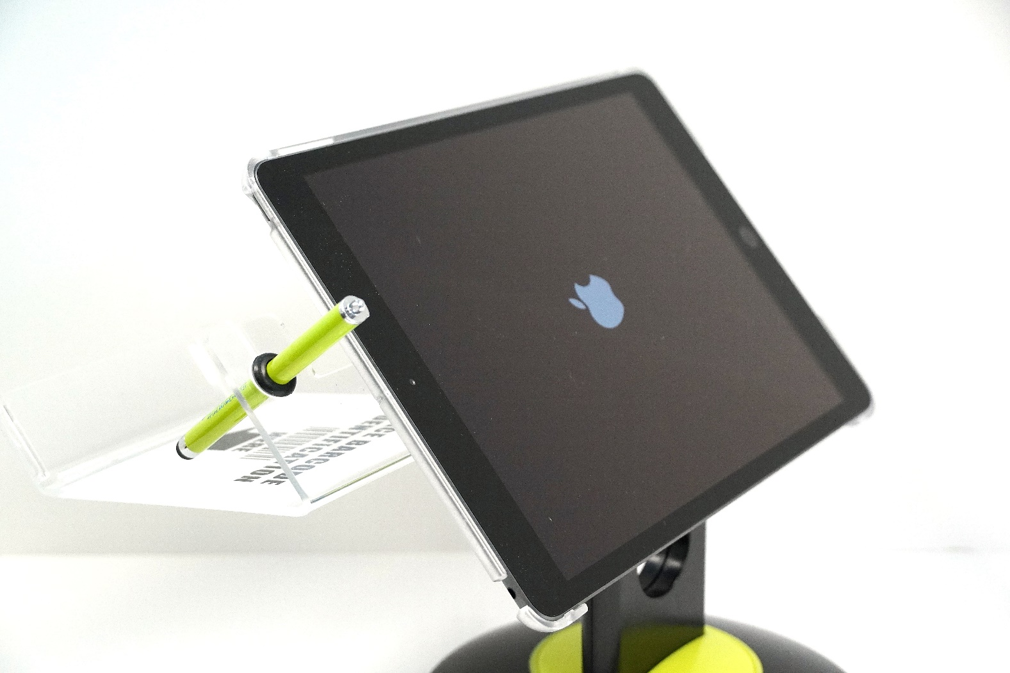
Equipment Set Up – Poll Pad
Press and hold power button until “Apple” logo appears
All issued poll pads must be powered on throughout the election.
Power Button

Slide 10
Equipment Set Up
Use only for intended purpose.

Slide 11
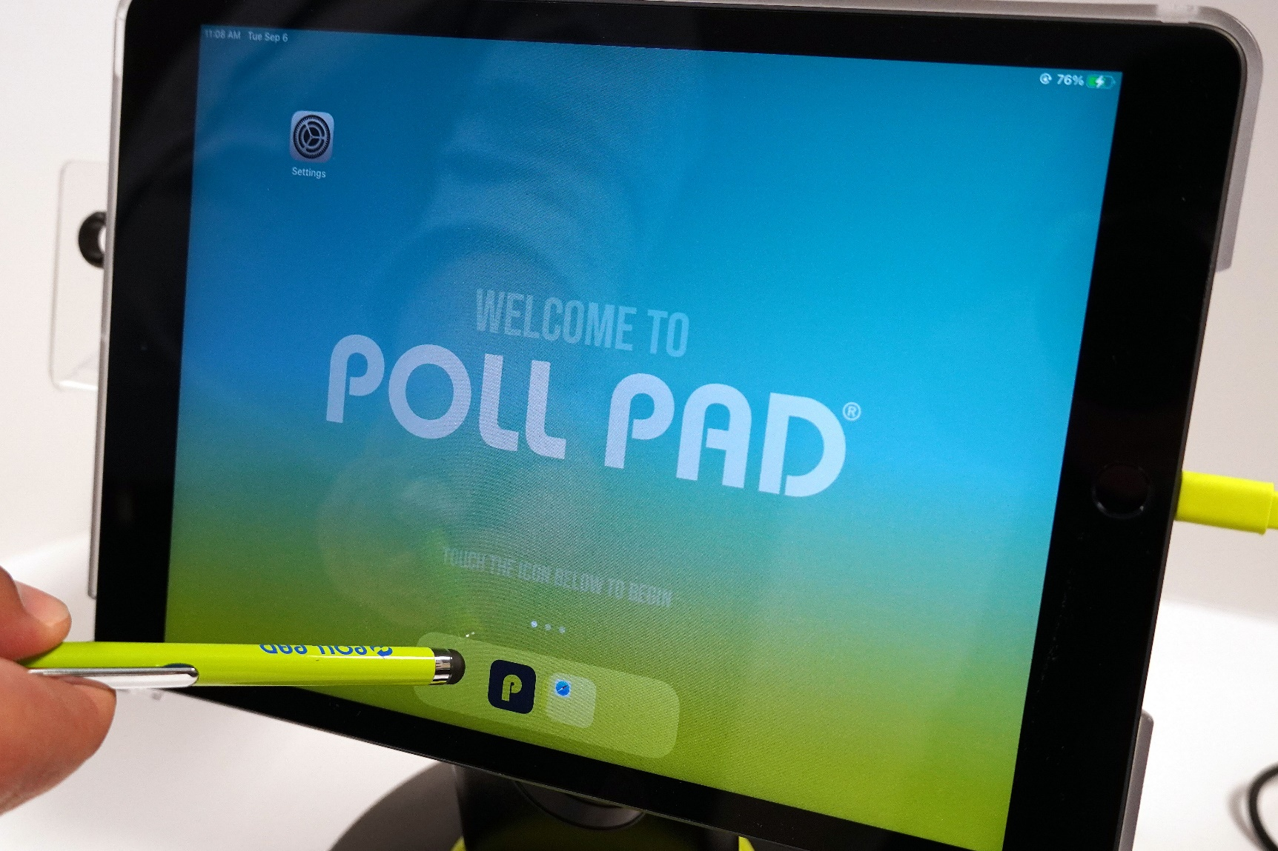
Equipment Set Up – Poll Pad
Press the “P” Icon.

Slide 12
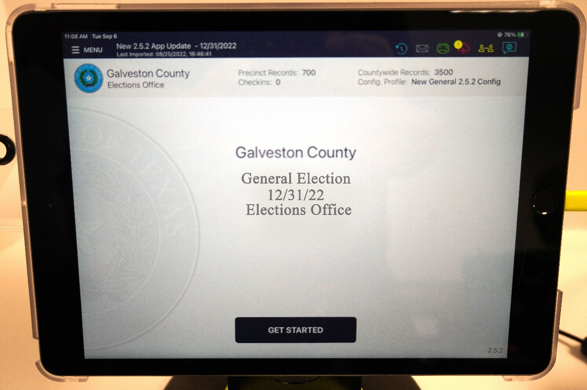
Verify location, election mode, and Check in Count.
Touch “Get Started”
Always use the stylus!
Check in Count
Election Mode
Location

Slide 13
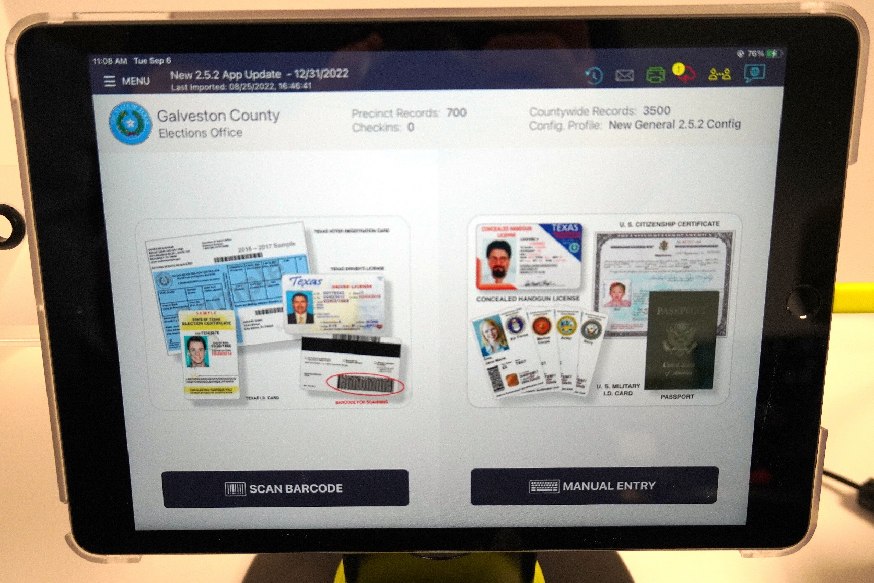
Equipment Set Up – Poll Pad
Ready to process voters!

Slide 14
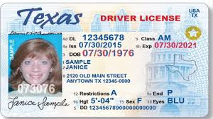
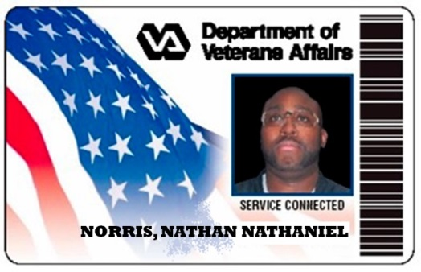
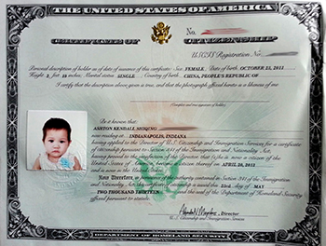
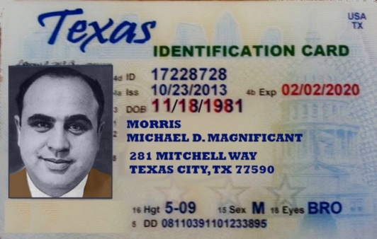
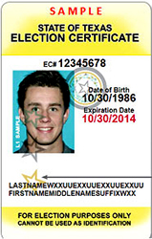
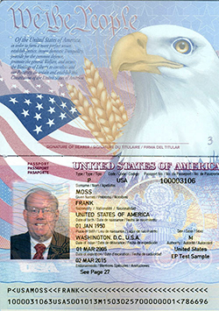
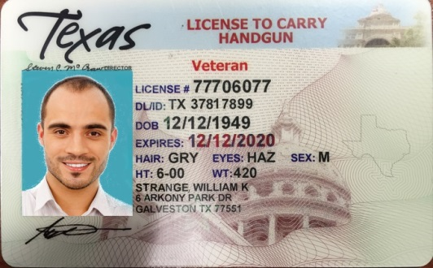
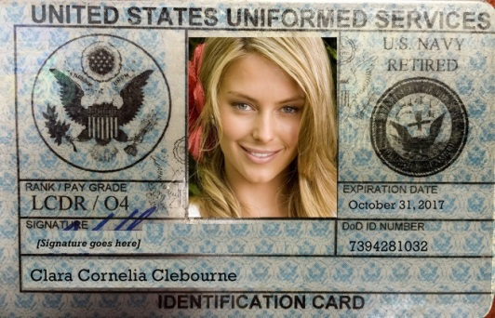
Normal Processing of Voters – Voter ID
Real ID
Exempt Voter
Valid from date

Slide 15
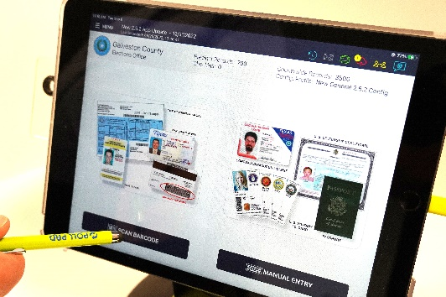
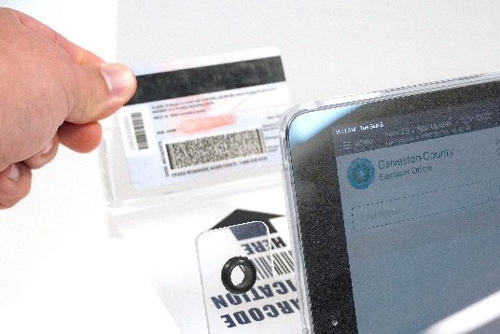
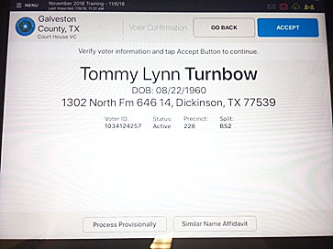
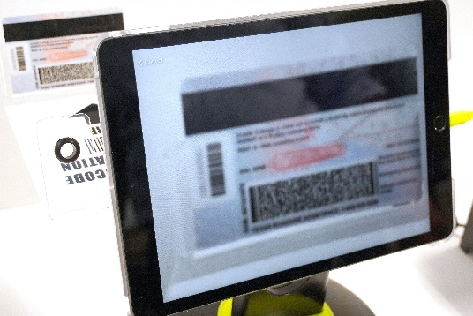
Normal Processing of Voters
Check in using Bar Code Scanner:
Choose “Scan Barcode.”
Insert ID on tray with barcode facing forward.

Slide 16
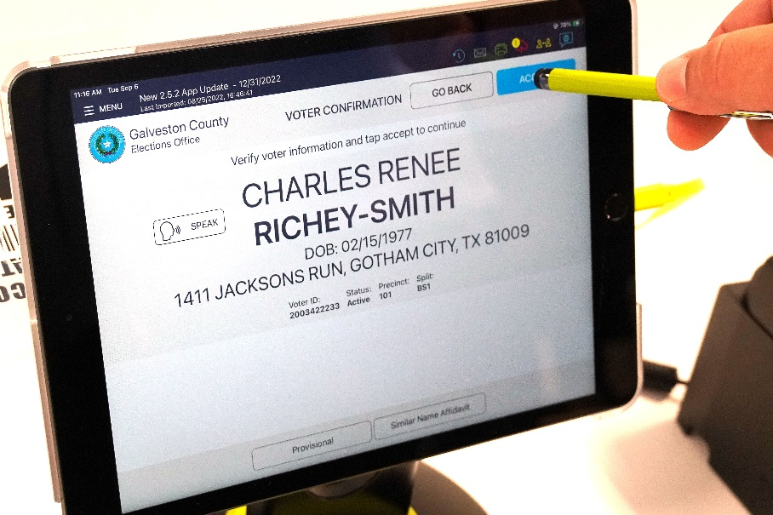
Normal Processing of Voters
Touch “Accept.”
Voter will choose party only during a primary election.
Accept party choice.

Slide 17
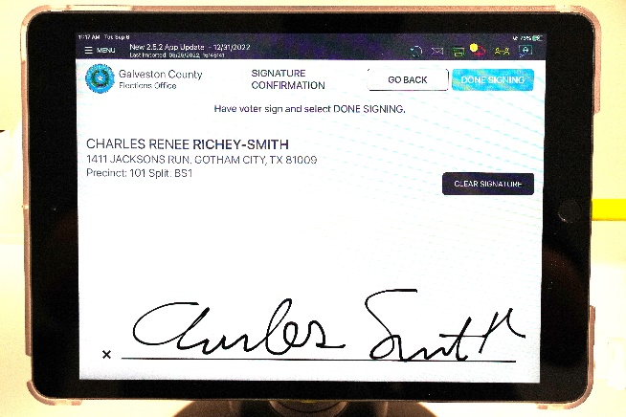
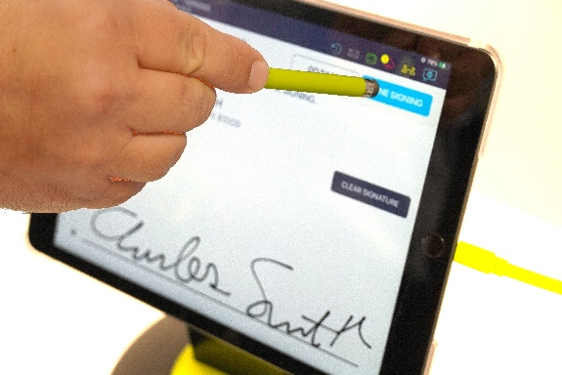
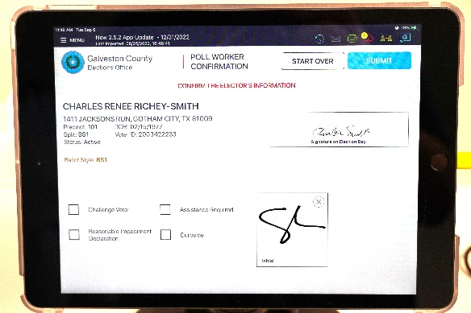
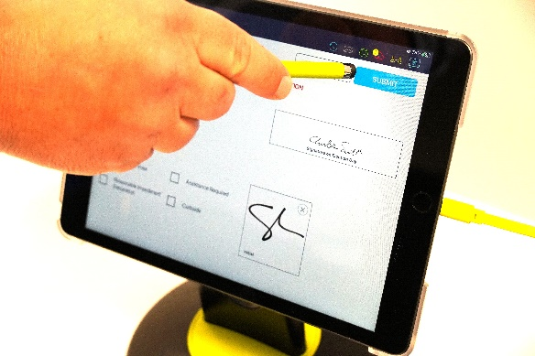
Normal Processing of Voters
Have Voter Verify info and sign.
Poll worker will choose done signing.
Poll worker will initial.
Choose submit and slip will print.
1
2
3
4

Slide 18
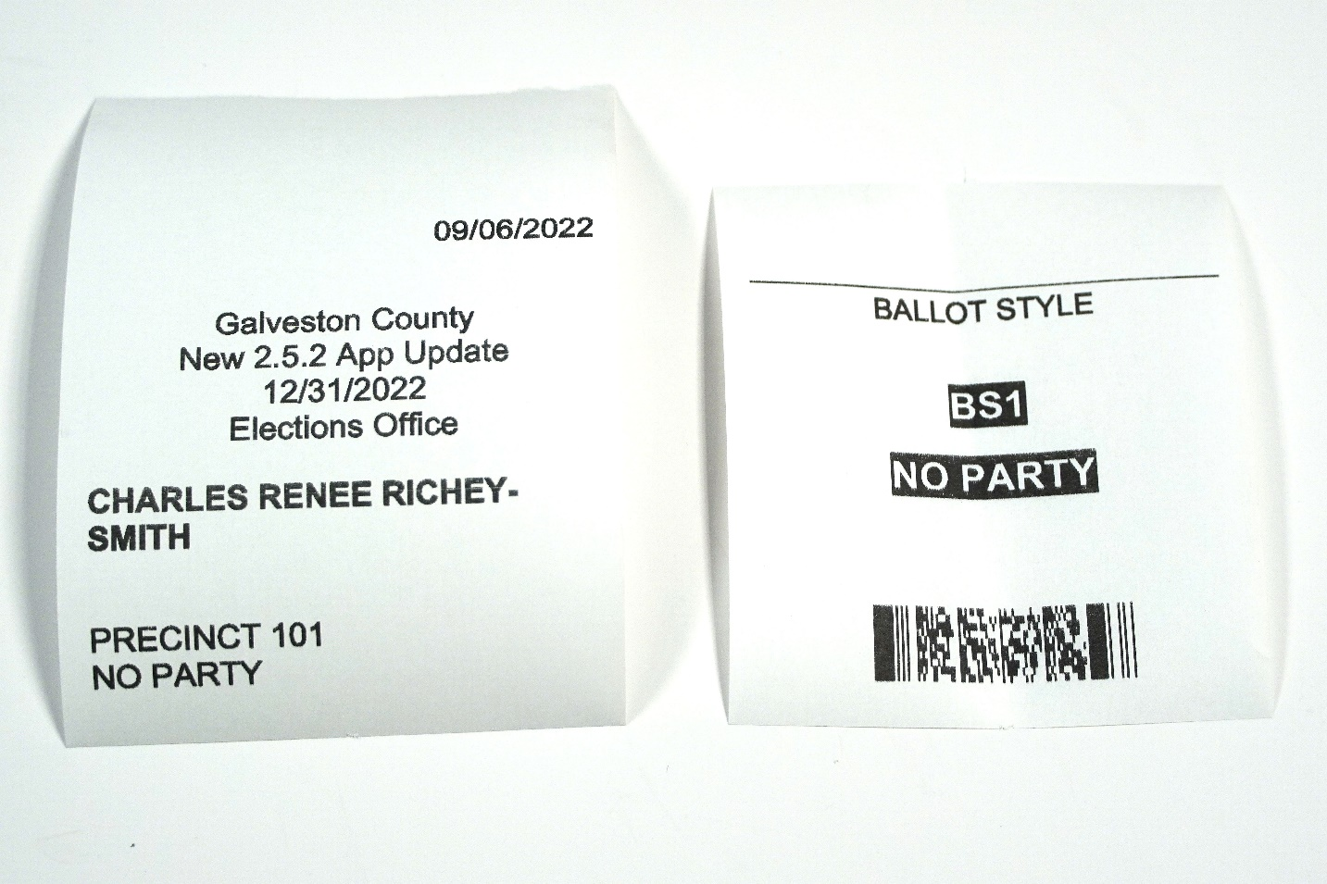
Normal Processing of Voters
The printed slip will be:
Scanned at the Controller

Slide 19
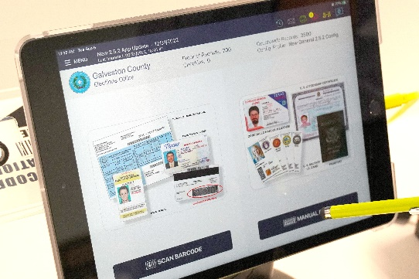
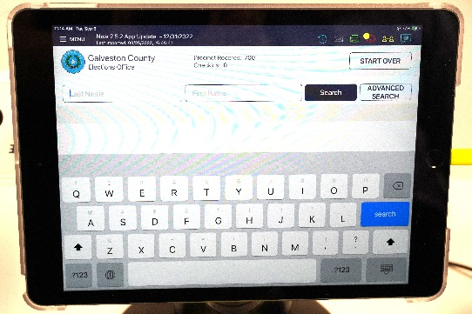
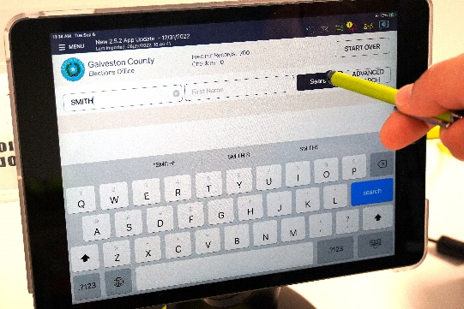
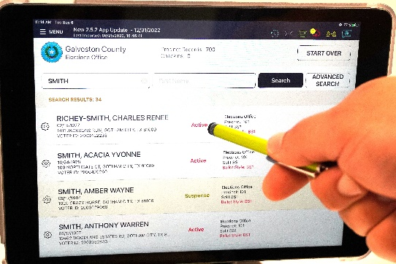
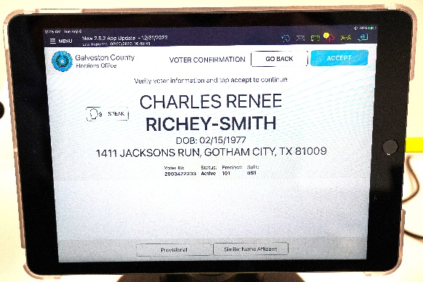
Normal Processing of Voters
Check in using Manual Entry:
Choose “Manual Entry.”
Enter only three letters from last and first name.
Tap “Search.”
Tap on the correct voter on the list.
Click accept and proceed as normal.

Slide 20
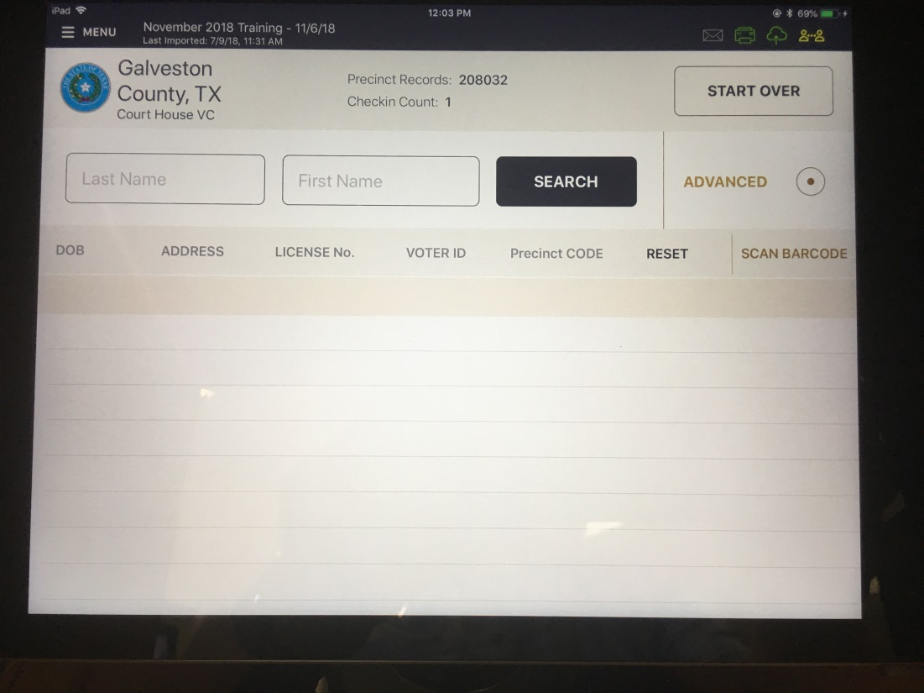
Special Circumstances
Steps to follow in order if voter is not found:
Try a manual entry if barcode scan was used.
Check data.
Touch advanced button.
Search on DOB, License No., or Voter ID.
Call Elections Division.

Slide 21
Special Circumstances
Voter does not present valid photo ID.
Clerk should show the voter the laminated list of acceptable photo IDs.
Must have a photo.
Must have an address (not necessarily current).
Expiration date must be within four years (Except voters 70+ years of age).
Clerk should ask if the voter possesses (owns) one of those.

Slide 22
Special Circumstances
Clerk should ask if the voter possesses (owns) one of those.
If the answer is “Yes.”
Voter may retrieve the ID and then vote regularly.
OR – Voter may vote provisionally and “Cure” within 6 days of Election Day. (Refer to the judge.)
If the answer is “No.” (Refer to the judge.)
Voter may obtain an acceptable ID and return to vote regularly (If time permits).
Vote provisionally – this will give the voter until the “cure” date to present a valid ID to the voter registrar.
Declare a reasonable impediment.

Slide 23
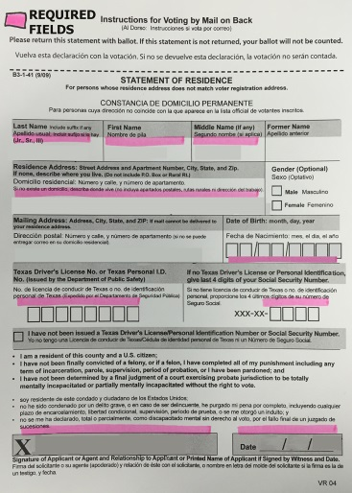
Special Circumstances
Voter has moved.
General rule = Voters vote where they live.
If they move within Galveston County:
Verify that they moved within the past 30 days.
Obtain a Statement of Residence.
Voter votes in the old precinct.
-OR- Voter votes provisionally in the new precinct.
Welch Raquel
589 Float Away Drive, Tiki Island 77554
P.O. Box 471, Tiki Island 77554 0 9 0 5 1 9 4 0
9 6 4 80 2 1 0
Raquel Welch 11 7 17

Slide 24
Special Circumstances
Voter has moved.
From another county within Texas.
During Early Voting, the voter may appear at the Elections Office (Justice Center) and vote a Limited Ballot.
Otherwise, the voter will vote provisionally.

Slide 25
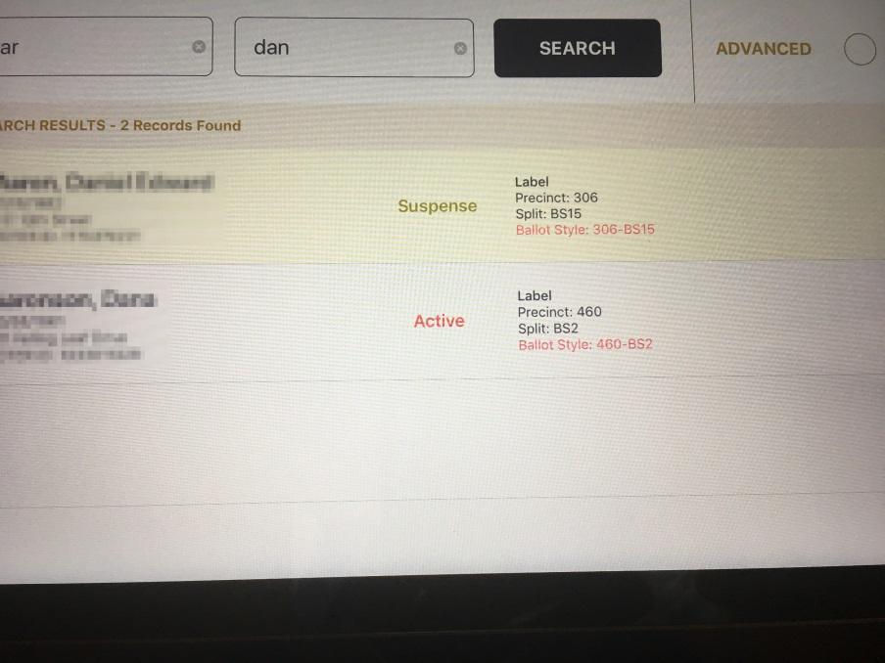
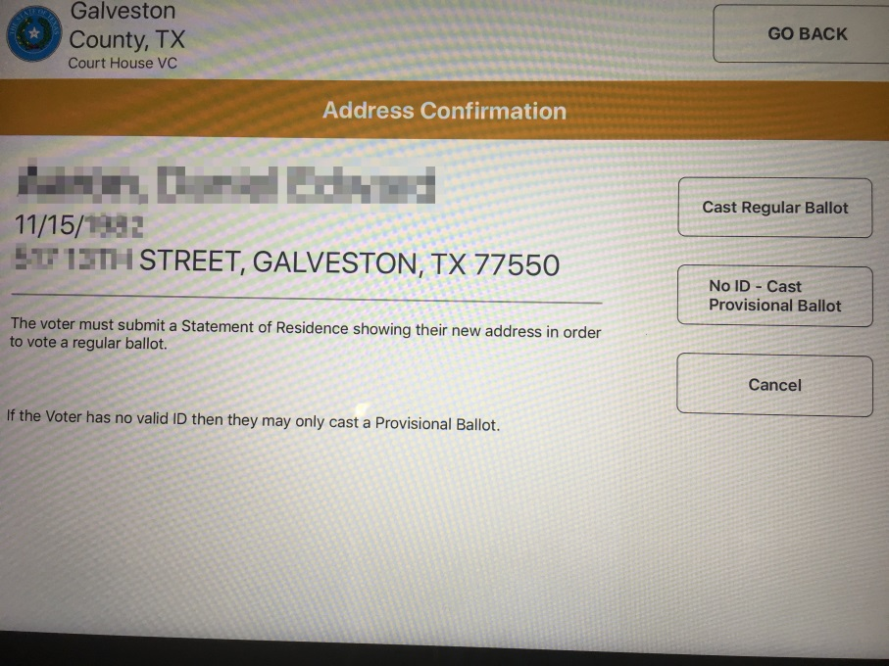
Special Circumstances
Suspense voters:
Indicated by label on the search page.
“Address Confirmation” on the process page.
This voter MUST fill out a Statement of Residence before casting a regular ballot.
Otherwise, he can only vote provisionally.

Slide 26
Special Circumstances
Duplicate Records:
If the voter has duplicate records please call Voter Registration at 409-766-2280.
They will make the changes that need to be made and tell you what VUID to use
Process the voter using the VUID given by Voter Registration

Slide 27
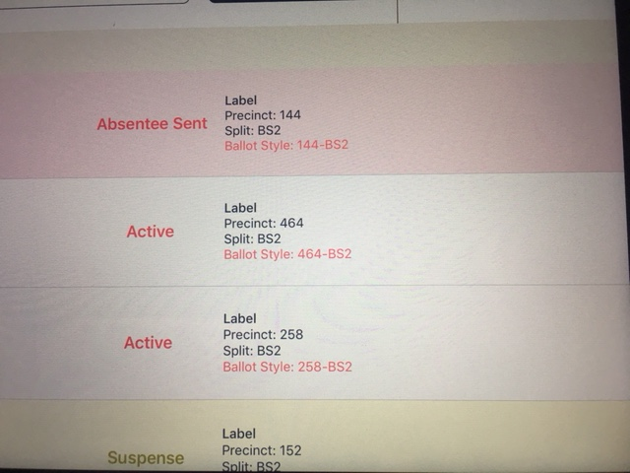
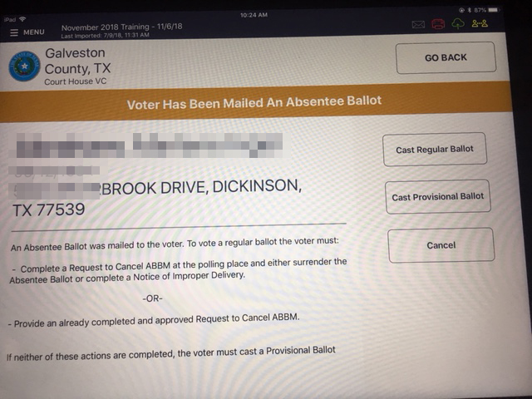
Special Circumstances
Mail Ballots:
If the voter has been sent a mail ballot, the record on the search screen will be pink with a notation.
The confirmation screen will have an amber banner.
Send to the Judge for cancellation paperwork.

Slide 28
Special Circumstances
Curbside Voter:
This is a regular voter to be processed by the poll-worker.
Someone presents the voter’s ID. (can be anyone)
Process through the Poll Pad (You may take the Poll Pad to the car for signature )
At the Duo choose a language and enter the access code.
Disconnect the Duo from its base station and Insert into the Duo Go.

Slide 29
Special Circumstances
Curbside Voter:
Two poll-workers take the Duo Go device to the voter.
Allow the voter to vote.
Make sure the voter touches “Print Ballot” when finished.
You will need to then insert the ballot into the Scanner.
Return the Duo device to the booth and reconnect.

Slide 30
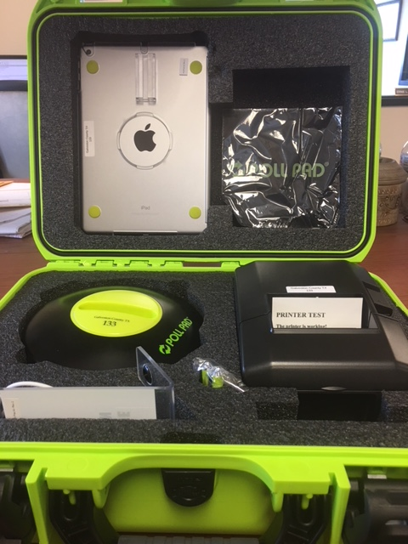
End of the Day
Please, pack and return the equipment as it was delivered!

Slide 31
End of the Day
Please help your Judge get the equipment and signage packed up and ready to go.
Make sure all tape is removed from floors and windows.
Make sure that all of your payroll is complete.
Help the Judge to make sure everything is ready return to the elections office.

Slide 32
Thank You for Serving with
Galveston County Elections

